Slide 1

Lesson 3 CN4003: Introduction to CSS with HTML II
Dr Fadi Safieddine
1

Slide 2
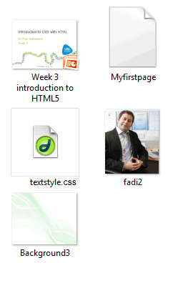
Last Lesson:
We got introduced to CSS
I am assuming you:
You have studied last week’s lecture.
You have practiced CSS!
You have now created your first HTML page.
You have checked your book from Kortex.
2

Slide 3
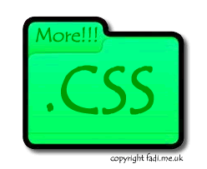
Lecture content
Section One:
Quick recap
More on CSS:
More on Classes in CSS.
Applying declaration to multiple elements.
Ways to assign color variations.
The Div Selector and layout design.
Advance CSS:
Assigning Conditions in CSS
ID Selector
3

Slide 4
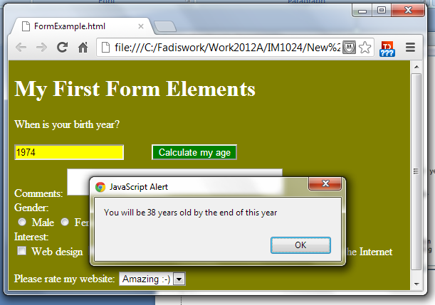
Lecture content
Section Two:
Creating Tables:
HTML Codes
CSS Styling
Creating Forms:
HTML Codes
CSS Styling
Images Referencing and the Assignment.
4

Slide 5
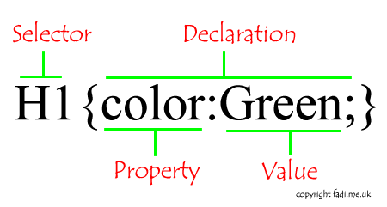
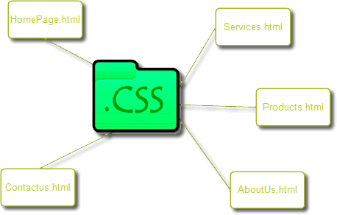
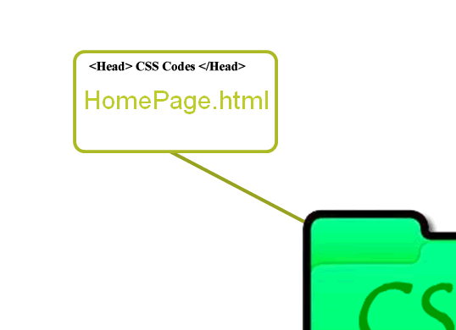
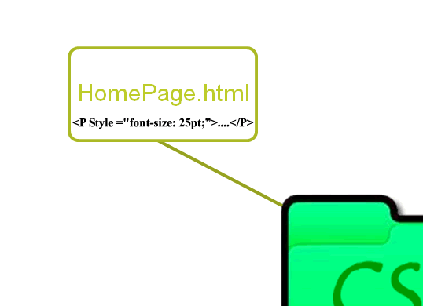
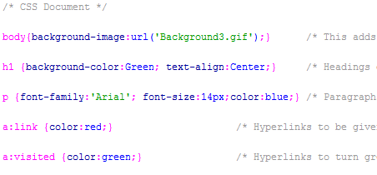
Quick recap
1. External 2. Embedded 3. Inline
5

Slide 6
CSS classes:
Defining a Class of Selectors:
.highlight {color:red; font-size: 14px;}
Again, you can define this at CSS file, Embedded or inline but depending where you put it then it may or may not be shared by other HTML files.
Using Class Selectors
<H1 CLASS=“highlight”>Important!</H1>
<P CLASS=“highlight”> Remember…</P>
REMEMBER: The tag word CLASS is used to execute the CSS code.
Lets’ see this in more examples.
6

Slide 7
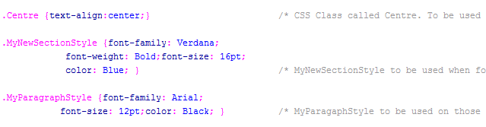
CSS Classes
Let's Define More Classes:
.Centre {text-align:center;}
.MyNewSectionStyle { font-family: Verdana; font-weight: Bold; font-size: 16pt; color: Blue; }
.MyParagraphStyle { font-family: Arial; font-size: 12pt; color: Black; }
Let's apply these to last lesson’s practice.
7

Slide 8
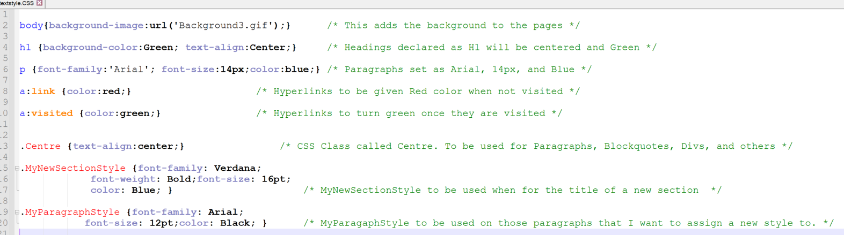
8
Notes:
You will find the demo page and its CSS in the folder of lesson 3

Slide 9
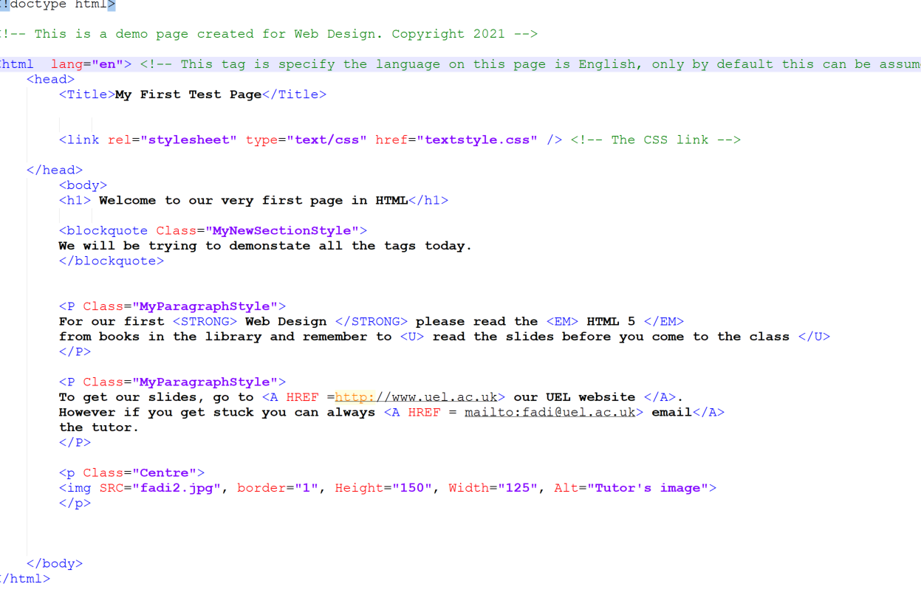
9
Notes:
You will find the demo page and its CSS in the folder of lesson 3

Slide 10
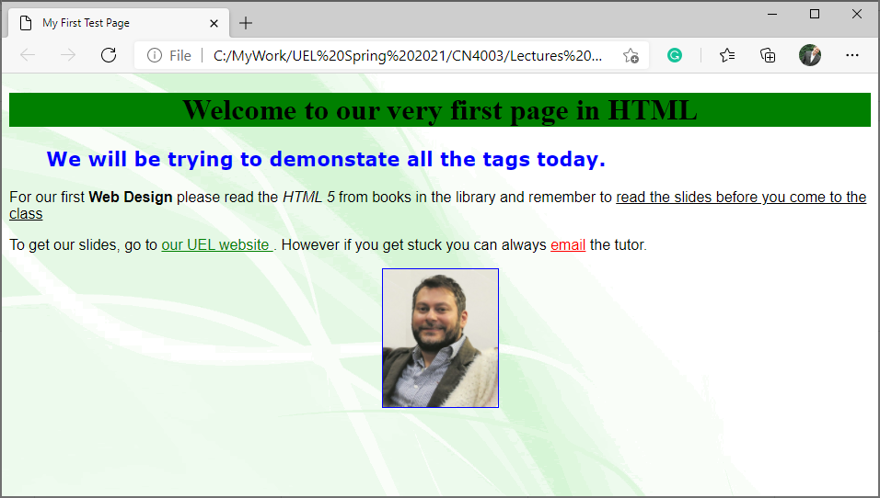
10

Slide 11
End of Part 1:
Activity 3.1. For the following CSS Classes, edit the code to fix the problems. Fix the text and submit online.
Centre. {text-align:middle;}
.MyNewSectionStyle { font-family: Verdana; font-weights: Bold; font-size: 16cm; color: Bluish; }
MyParagraphStyle { font-family: Areal; font-size: 12pt; color: Black.jpg; }

Slide 12
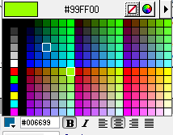
More CSS Codes
12

Slide 13
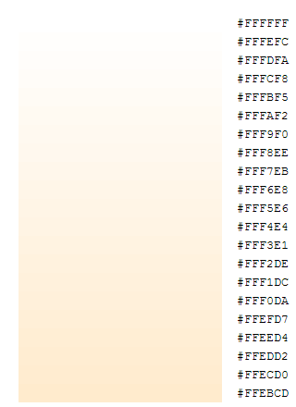
More CSS Codes
Multiple Selectors assigned same declaration:
h1, h2, h3 { color: White; }
Different ways of selection colours:
By naming: (17 colours) aqua, black, blue, fuchsia, gray, grey, green, lime, maroon, navy, olive, purple, red, silver, teal, white, and yellow.
Hexadecimal Value: This can give you millions of shades.
#FFFFFF (White) can have many shades
h1, h2 { color: #FFEBCD; }
How to get the right shade?
Graphic packages (Photoshop, Fireworks, and others)
Websites: https://www.w3schools.com/colors/colors_mixer.asp
13

Slide 14
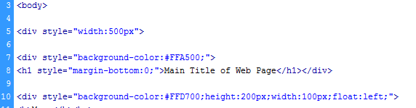
More CSS Codes
DIV Selector:
Stands for Division.
Maybe used to divide your page into sections and control each section.
Ultimately it is mostly used for layout design of a page.
Tag: <Div>....</Div>
Some key Attributes:
Height & Width: In Pixels (200px) or could be by percentage of the screen (70%)
Background-color: See previous slide.
Float: Aligning the Div to the right or left
Absolute Positioning using: Position, Left, Top, & Z-index.
We shall look at three examples of using Div tag.
14

Slide 15
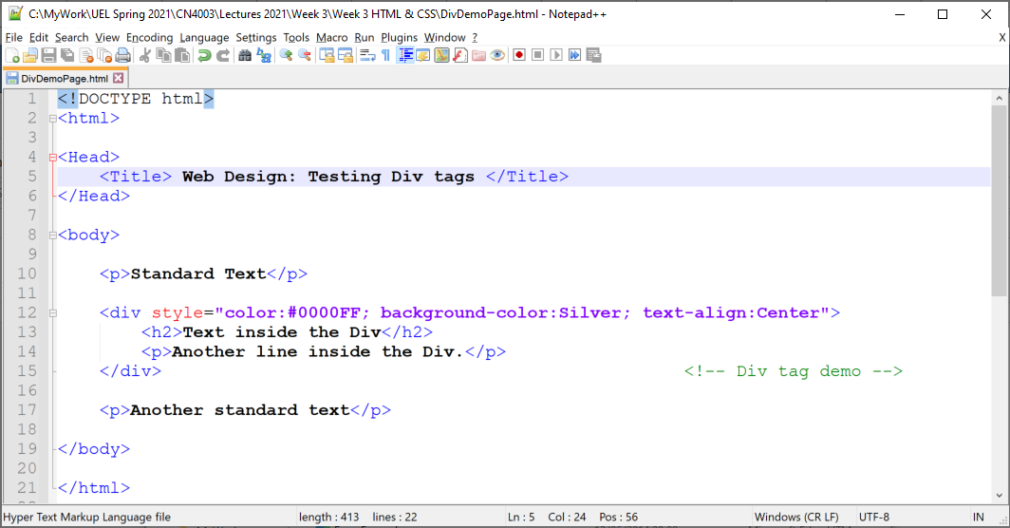
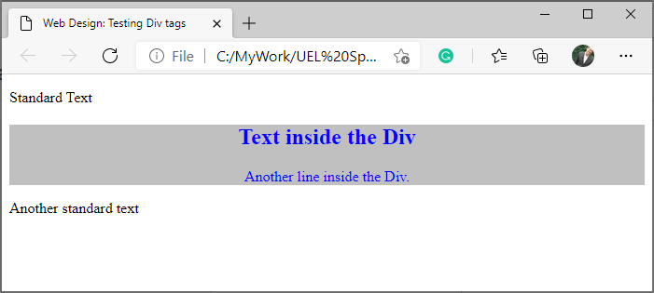
More CSS Codes
First Example:
Simple Div example:
15

Slide 16
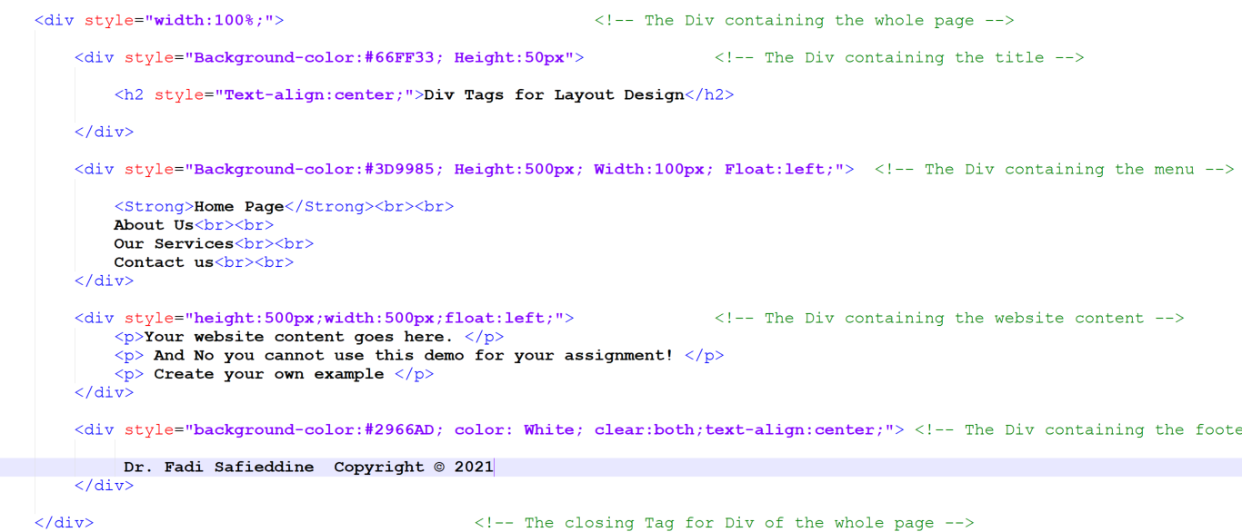
More CSS Codes
Second Example:
Layout Design:
16

Slide 17
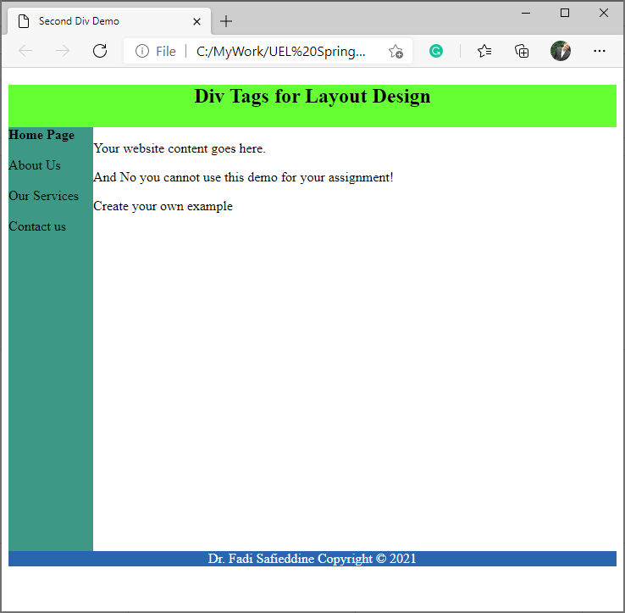

Slide 18
More CSS Codes
DIV Selector:
Finally using Layered Div
For this we specify location and layer:
Using:
Position: Absolute or relative to the document.
Left & Top: location in pixels
Z-index: indicates sequence in case of several layers:1,2,3..
We can also specify border style:
Border-width, Border-style, & Border-color
Let's demonstrate this by creating three-layer Divs:
One Blue, One Green and One Yellow
18

Slide 19
More CSS Codes
DIV Selector: Third Example
<!-- First is the Yellow Div with location Left 100px and Top 20px -->
<div style=" Background-color: yellow; text-align:center; position:absolute; left:100px; top:20px; Z-index:1; width:230px; height:100px; border-width: 3px; border-style: dotted; border-color: red; ">
<h2>Playing with Divs</h2>
<p> Positioning </p>
</div>
>> Now we created two more in Green and Blue. But so as they would not fall on top of each other, we moved their locations to:
Green one (left:120px; top:110px; Z-index:2;)
Blue one (left:250px; top:50px; Z-index:3;)
19

Slide 20
More CSS Codes
DIV Selector: Third Example
<!-- First is the Yellow Div with location Left 100px and Top 20px -->
<div style=" Background-color: yellow; text-align:center; position:absolute; left:100px; top:20px; Z-index:1; width:230px; height:100px; border-width: 3px; border-style: dotted; border-color: red; ">
<h2>Playing with Divs</h2>
<p> Positioning </p>
</div>
>> Now we created two more in Green and Blue. But so as they would not fall on top of each other, we moved their locations to:
Green one (left:120px; top:110px; Z-index:2;)
Blue one (left:250px; top:50px; Z-index:3;)
20

Slide 21
More CSS Codes
DIV Selector: Third Example
<!-- First is the Yellow Div with location Left 100px and Top 20px -->
<div style=" Background-color: yellow; text-align:center; position:absolute; left:100px; top:20px; Z-index:1; width:230px; height:100px; border-width: 3px; border-style: dotted; border-color: red; ">
<h2>Playing with Divs</h2>
<p> Positioning </p>
</div>
>> Now we created two more in Green and Blue. But so as they would not fall on top of each other, we moved their locations to:
Green one (left:120px; top:110px; Z-index:2;)
Blue one (left:250px; top:50px; Z-index:3;)
21

Slide 22
More CSS Codes
DIV Selector: Third Example
<!-- First is the Yellow Div with location Left 100px and Top 20px -->
<div style=" Background-color: yellow; text-align:center; position:absolute; left:100px; top:20px; Z-index:1; width:230px; height:100px; border-width: 3px; border-style: dotted; border-color: red; ">
<h2>Playing with Divs</h2>
<p> Positioning </p>
</div>
>> Now we created two more in Green and Blue. But so as they would not fall on top of each other, we moved their locations to:
Green one (left:120px; top:110px; Z-index:2;)
Blue one (left:250px; top:50px; Z-index:3;)
22

Slide 23
More CSS Codes
DIV Selector: Third Example
<!-- First is the Yellow Div with location Left 100px and Top 20px -->
<div style=" Background-color: yellow; text-align:center; position:absolute; left:100px; top:20px; Z-index:1; width:230px; height:100px; border-width: 3px; border-style: dotted; border-color: red; ">
<h2>Playing with Divs</h2>
<p> Positioning </p>
</div>
>> Now we created two more in Green and Blue. But so as they would not fall on top of each other, we moved their locations to:
Green one (left:120px; top:110px; Z-index:2;)
Blue one (left:250px; top:50px; Z-index:3;)
23

Slide 24
More CSS Codes
DIV Selector: Third Example
<!-- First is the Yellow Div with location Left 100px and Top 20px -->
<div style=" Background-color: yellow; text-align:center; position:absolute; left:100px; top:20px; Z-index:1; width:230px; height:100px; border-width: 3px; border-style: dotted; border-color: red; ">
<h2>Playing with Divs</h2>
<p> Positioning </p>
</div>
>> Now we created two more in Green and Blue. But so as they would not fall on top of each other, we moved their locations to:
Green one (left:120px; top:110px; Z-index:2;)
Blue one (left:250px; top:50px; Z-index:3;)
24

Slide 25
More CSS Codes
DIV Selector: Third Example
<!-- First is the Yellow Div with location Left 100px and Top 20px -->
<div style=" Background-color: yellow; text-align:center; position:absolute; left:100px; top:20px; Z-index:1; width:230px; height:100px; border-width: 3px; border-style: dotted; border-color: red; ">
<h2>Playing with Divs</h2>
<p> Positioning </p>
</div>
>> Now we created two more in Green and Blue. But so as they would not fall on top of each other, we moved their locations to:
Green one (left:120px; top:110px; Z-index:2;)
Blue one (left:250px; top:50px; Z-index:3;)
25

Slide 26
More CSS Codes
DIV Selector: Third Example
<!-- First is the Yellow Div with location Left 100px and Top 20px -->
<div style=" Background-color: yellow; text-align:center; position:absolute; left:100px; top:20px; Z-index:1; width:230px; height:100px; border-width: 3px; border-style: dotted; border-color: red; ">
<h2>Playing with Divs</h2>
<p> Positioning </p>
</div>
>> Now we created two more in Green and Blue. But so as they would not fall on top of each other, we moved their locations to:
Green one (left:120px; top:110px; Z-index:2;)
Blue one (left:250px; top:50px; Z-index:3;)
26

Slide 27
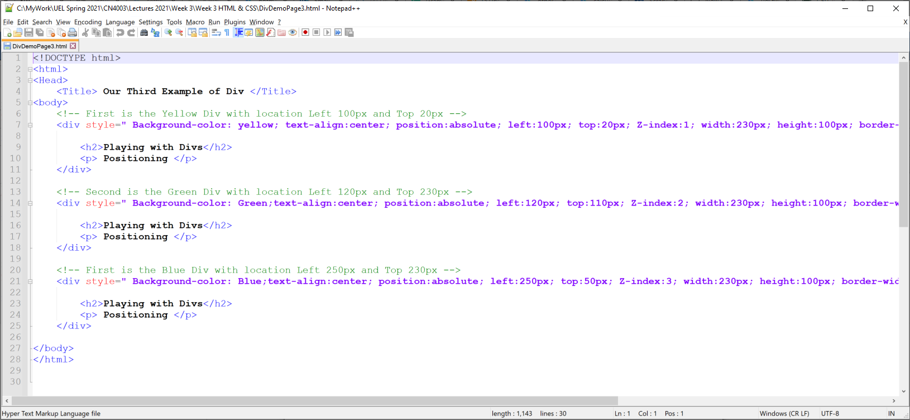
Third example :CSS Codes
27

Slide 28
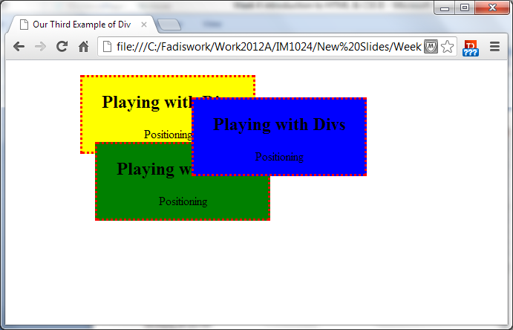
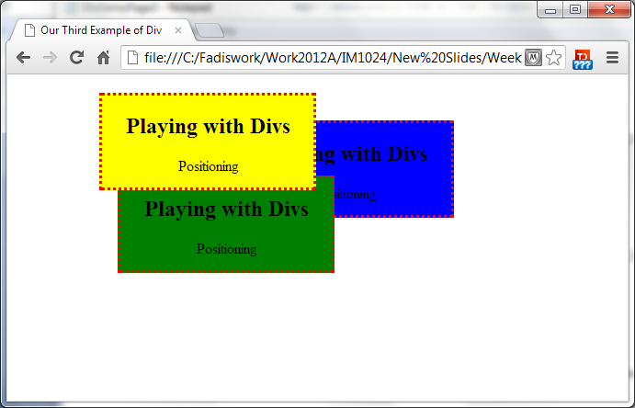
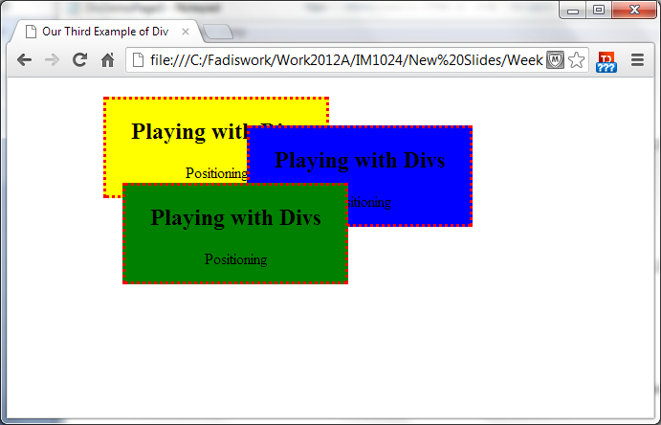
Third example:CSS Codes
You can change sequence of the layers by simply change the Z-index sequence of each later
28

Slide 29

End of Part 2
Activity 3.2. We have three layers in the following order as shown in the image, order the Z-index of the layers correctly:

Slide 30
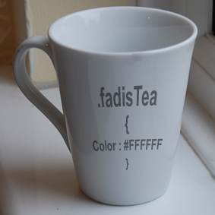
More CSS & HTML Codes
30

Slide 31
More CSS Codes
ID Selector:
Like the concept of CLASS where we give a unique name a set of rules and we call them from the HTML document.
Syntax: #Name{ Declaration}
< Tag ID=“Name...>
Only with ID’s you should not call them more than once in one single HTML file.
CLASS
.highlight {color:red; font-size: 14px;}
……………….
………………
<H1 CLASS=“highlight”>Important!</H1>
<P CLASS=“highlight”> Remember…</P>
ID
#highlight {color:red; font-size: 14px;}
……………….
………………
<H1 ID=“highlight”>Important!</H1>
<!-- You should not duplicate IDs -->
31
Notes:
While Classes and Ids can be used for doing the same things, there are two essential differences. ID should not be duplicated!

Slide 32
More CSS Codes
Conditions in Styling:
Maybe you styled all your paragraphs to be:
P {font-size:12pt ; color: blue}
but if the paragraph has tag <B> for bold as well then you want to change the style completely to:
{font-size:14pt ; color: black;}
Yes, you can!
P B {font-size:14pt ; color: black;}
32

Slide 33
More CSS Codes
Conditions in Styling:
P B {font-size:14pt ; color: black;}
This setting does not care if the P tag comes before B tag or vice versa.
If the sequence is important to you, then you can specify it as well:
P > B {font-size:14pt ; color: black;}
This means only when a B tag is contained within a Paragraph then the size and color would change.
In this example: the B tag is called “Child” Selector whereas the P tag is called “Parent” Selector.
33

Slide 34
Lab Practice 3.1:
Study the slides and notes
Practice the new CSS codes
Combine MyFirstpage.html with DivDemoPage2.html codes.
Change the text and images to yours.
34

Slide 35
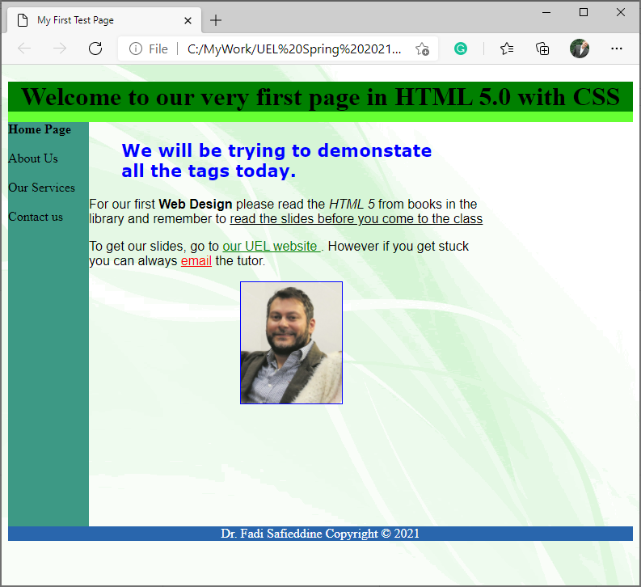
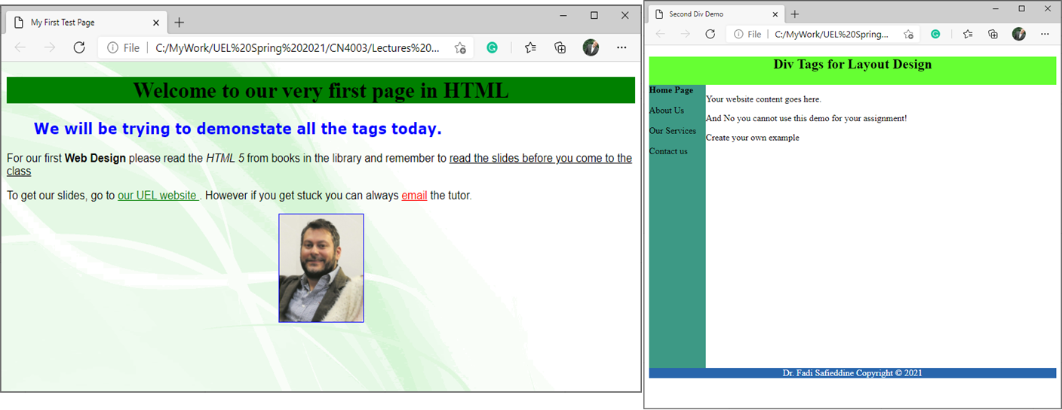

Slide 36
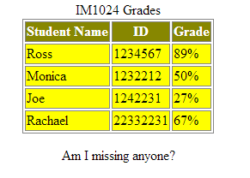
Basic HTML Tables
Tables help us organize data into rows and columns
table attributes are:
Border
Specifies the table’s border width in pixels
Caption
Describes the table’s content and helps text-based browsers interpret table data
Head section (header cell, defined with a thead element). Contains header information such as column names
tr element (defines an individual table row)
th element (defines the columns in the head section)
Table Footer (defined with a tfoot element)
Table Body (defined with a tbody element)
Data cells (defined with td element)
36

Slide 37
Basic HTML Table

Slide 39
39

Slide 40
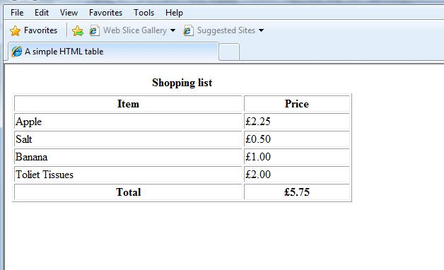
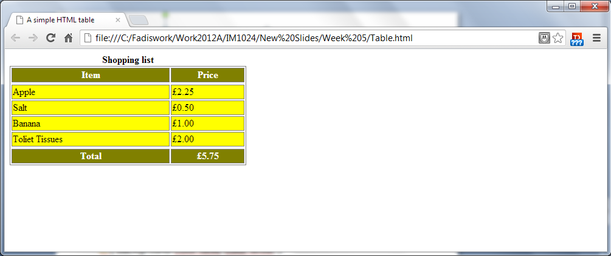
What is missing here is some styling:
<style>
table, td, th { border:1px solid gray;}
th { background-color:olive; color:white; }
td{ background-color:yellow; }
</style>
You can add these styles to the external CSS (without the word Style), embed it in the HTML file, or online.
40

Slide 41
End of Part 3
Activity 3.3: Identify the meanings of these table tags:
<Table>
<TR>
<TH>
<TD>
<CAPTION>
<THEAD>
<TFOOT>
<TBODY>

Slide 42
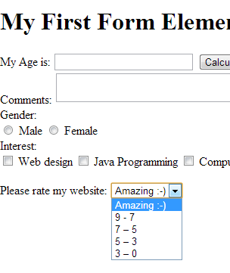
Creating HTML Form:

Slide 43
Creating HTML Form:
Forms represent a mechanism to collecting or processing information from people viewing the website.
We use tags <Form>…</Form>
Lets start by viewing how to create two objects on an HTML page: Text Box and buttons.
To create a text box:
<INPUT NAME = "year" TYPE = "text" SIZE ="25">
We specify name for object, a type, and size.
Note that these codes appear with in the body tags <body>…</body>.

Slide 44
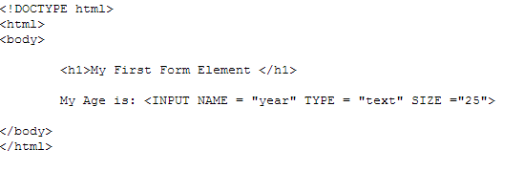
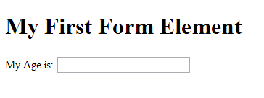
Creating HTML Form:

Slide 45
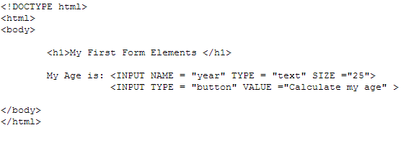
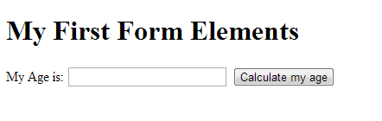
Creating HTML Form:
To create a button:
<INPUT TYPE = "button" VALUE ="Calculate my age" >
We specify name for object, and caption is stored in ‘value’. This will display a button with caption saying ‘Calculate my age’

Slide 46
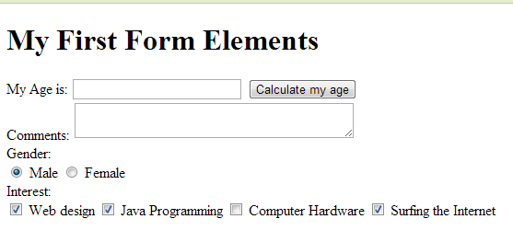
Creating HTML Form
Create a multi-line text box:
Your Comments: <TEXTAREA NAME= “comments” ROW = “4” COLS = “36”> </TEXTAREA>
Create a radio box:
Select Gender: <INPUT NAME= “gender” TYPE = “radio” VALUE = “Male”> Male …
Create check box:
Interest? <INPUT NAME= “reply” TYPE = “checkbox” VALUE =“Require reply”> Web Design

Slide 47
Creating HTML Form
Create drop down menu:
Rate my website:
<SELECT NAME = “rating”>
<OPTION SELECTED> Amazing :-)
<OPTION> 9 - 7
<OPTION> 7 – 5
<OPTION> 5 – 3
<OPTION> 3 – 0 </SELECT>
47

Slide 48
Styling HTML Form:
You can style your forms in CSS. Lets apply it to our last example:
<style>
body { background-color:olive; color:white;}
input[type="text"]
{ width:150px; margin-bottom:10px; background-color:yellow; }
input[type="button"]
{ width:120px; margin-left:35px; background color:green; color: white; }
</style>
48

Slide 49
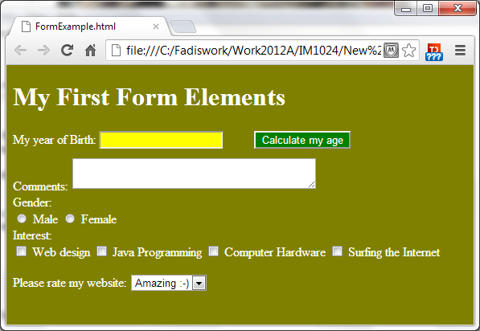
49

Slide 50
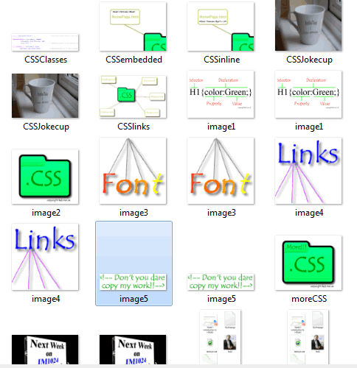
Using Images:
1- Ideally students should create their own images or use images from websites that explicitly state copyright free images. You still have to reference it.
http://search.creativecommons.org/ (Good source)
2- We understand that to give the website a professional look: Images, pictures, and backgrounds professionally done may sometimes be needed.
Students still need to clearly reference all their images to their sources in the documentation. Failure to do so would be considered cheating and subject to Breach of Regulations.
3- Students should not use images that have watermarks on them.
4- Students should not use the websites they created for anything other than their assignment submission unless all the images legally free for their use.
50

Slide 51
Lab practice 3.2
Create a table and submission form for this module where students can see their timetable and submit request to change their groups.

Slide 52
End of Part 4
Identify the meaning of these Form Tags, what do they do?
<TEXTAREA NAME= “Complaints” ROW = “4” COLS = “36”> </TEXTAREA>
<INPUT NAME= “Do you agree?” TYPE = “radio” VALUE = “Yes”> Yes </INPUT>
<INPUT NAME= “Tick” TYPE = “checkbox” VALUE =“Acceptance”> I agree to the terms and conditions </INPUT>
<INPUT TYPE = "button" VALUE =“Send Email" >
<INPUT NAME = “Name" TYPE = "text" SIZE ="25">

Slide 53
Assignment

Slide 54
Task 1
Task 1 - The Case Study: Present your case study based on the topic presented above. Present the overall requirements of such a website. (L.O.2., 400 words, 5%)
Background:
Bicycle rental service is becoming a popular business model in many cities for locals, tourist, business delivery, and higher education students. They are seen as a cheaper and more environmentally friendly option. Research and create a website that promotes a bicycle rental service. Focus on a small business model as opposed to large scale big business models.

Slide 55
Task 2
Task 2- Background Research: Review at least ten websites promoting businesses of the similar to your case study. Reflect on the design, usability, features (functionality) accessibility, and legal requirements of these websites. Present a summary of your analysis and a summarised tabular list of the websites you visited. (L.O.1. and L.O.7, 700 words, 10%)

Slide 56

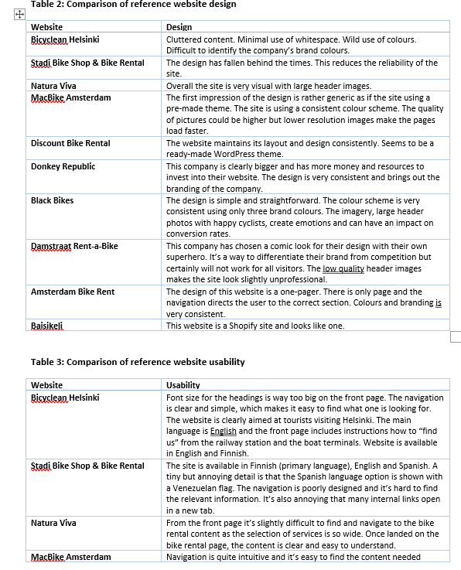
Review of the assignment
56

Slide 57
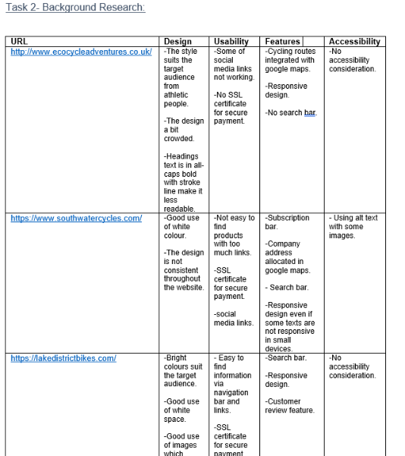
Review of the assignment
57

Slide 58
Task 3
Task 3- Web Planning: Using a defined approach to modelling, present a plan for your website to include design, usability, functionality, and accessibility features. Your plans should separate the design specification from the content. Make your web technologies recommendations, choice of URL, service provider, and method of implementation. (L.O.1. and L.O.2., 700 words, 20%).

Slide 59
Task 4
Task 4- Implementation** and Testing: Implement your website and provide testing logs. You should provide screenshots of every page with an explanation of any design, usability, functionality, and accessibility features included. Label your screenshots appropriately. The HTML codes to be provided in the appendix. Ensure that the document is presented in a professional structure. The website needs to have the following elements: HTML, CSS, HTML comments, images, lists, forms, and navigation. Testing should include logs of each page as well as W3C validation reports. (L.O.3, L.O.4., and L.O.8, 700 words, 50%)
**Students are not allowed to use websites or software that generates for there assignment. For example, use of Wix, WordPress, Dreamweaver, or any software or templates. The use of these tools will be reported as breach of regulations.

Slide 60
Task 5
Task 5- Evaluation and Reflection: Evaluate your website site and reflect on your Background Research (Task 2). Suggest ways to optimise your website using search engines, mobile accessibility, advertising revenues, and local exposure. (L.O.5. and L.O.6, 500 words, 15%).

Slide 61
Next Week:
Learn web modelling.
Publishing your work online.
We will have accounts created for you. Please make sure you check your email next week for instructions.
Publishing your work is optional but we strongly encourage you to do that.
61

Slide 62
Thank you!

